Slide 1
Amazon Sales Analysis
Presented by :Abhilash Buragohain

Slide 2
Introduction
Sales management has gained importance to meet increasing competition and the need for improved methods of distribution to reduce cost and to increase profits. Sales management today is the most important function in a commercial and business enterprise.

Slide 3
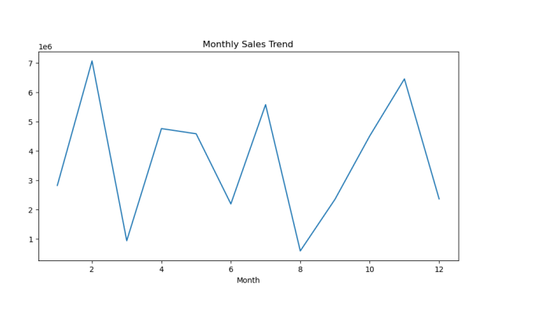
Sales of Monthly Trends
We obserb from the graph that the sales were highest in the month of Febuary and lowest in the month og August

Slide 4
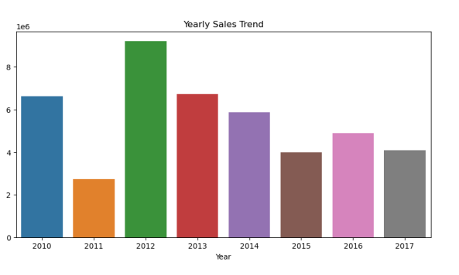
Sales Yearly Wise
IN 2012 sales were Higest in 2011 sales were lowest

Slide 5
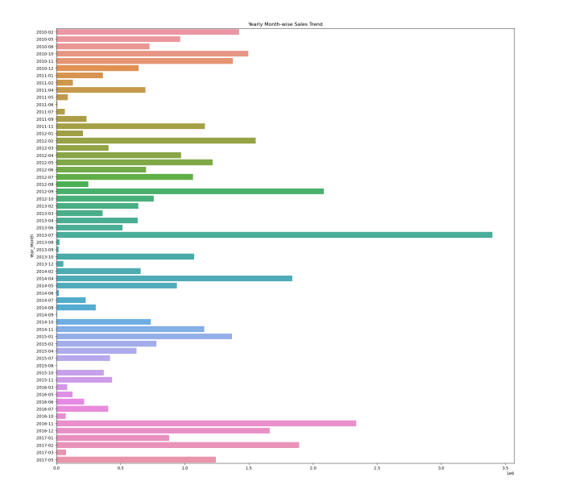
Yearly_month Wise trends
We obserb that in july year of 2013 Sales were higest through out the year and in 2011-06 sales were lowest through out the year

Slide 6
Main KPIs
1. Total Sales
2. Total Profit
3. Average Unit Price
4. Average Unit Cost
5. Total Units Sold
6. Average Profit per Unit
7. Average Profit per Order
8.Top Selling Item Type
9.Top Selling Country

Slide 7
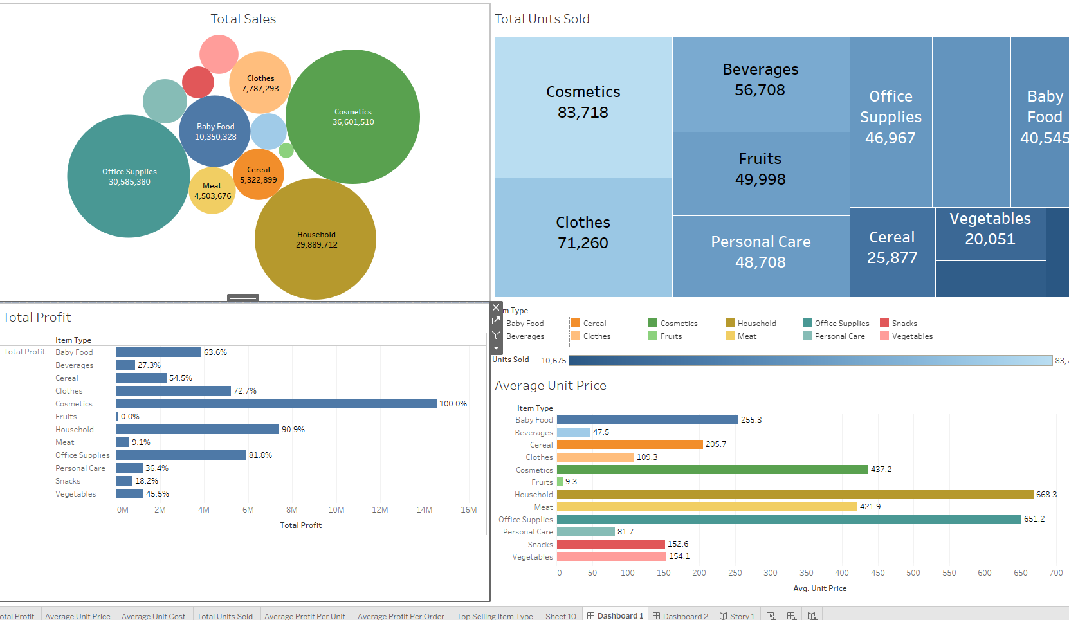
Dashboards

Slide 8
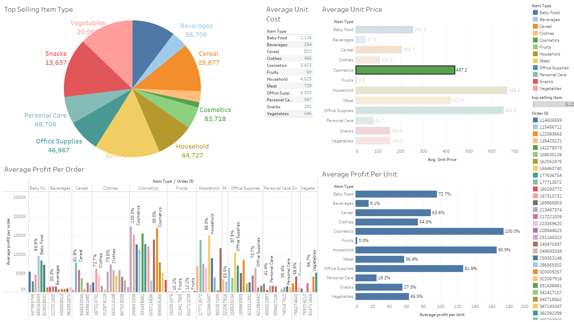
Dashboard 2

Slide 9
Thank You

